Slide 1


Learn to Play
Martin Yates

Slide 2
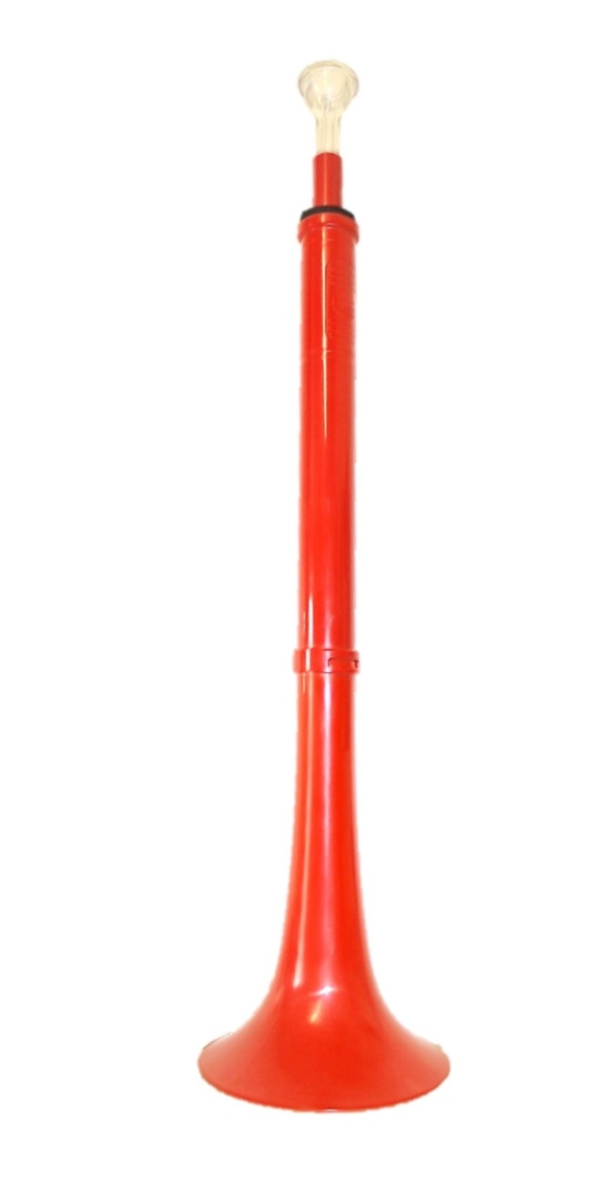
Here’s your pBuzz….
Have a look and explore what can you see on your pBuzz?

Slide 3
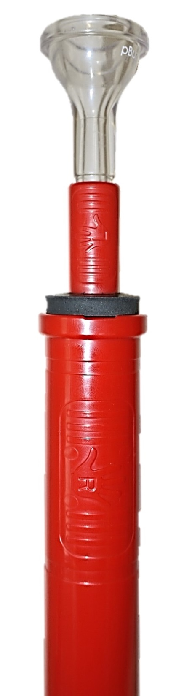
Your teacher will show you how to hold your pBuzz, can you see where each hand should go?
Make sure you’re standing tall, like a soldier!

Slide 4



I’m A Little Bee

Slide 5
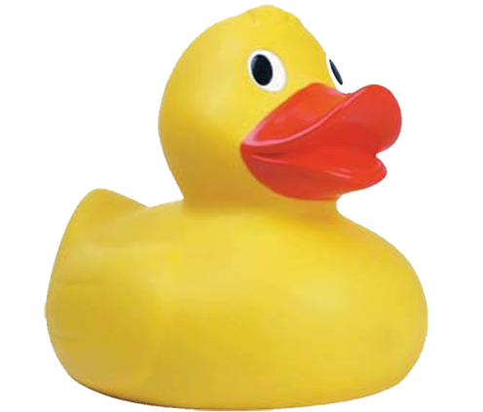

I’m a Little Duck

Slide 6
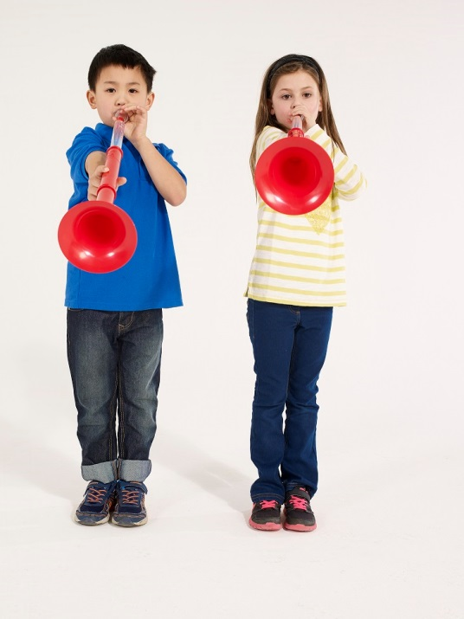
Can you copy me?
I’m going to play some 4 beat rhythms and I would like you to copy them back to me

Slide 7
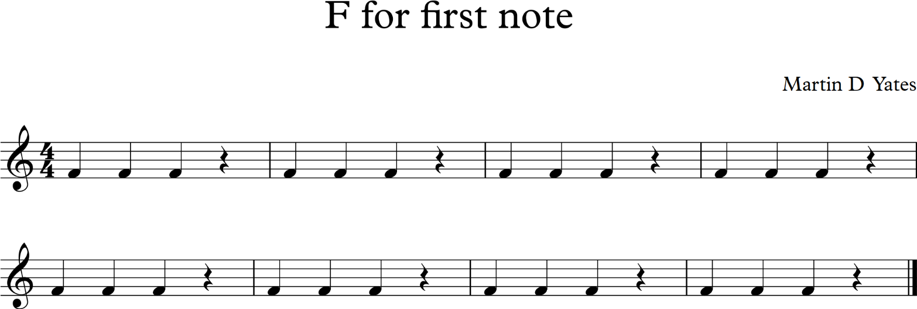
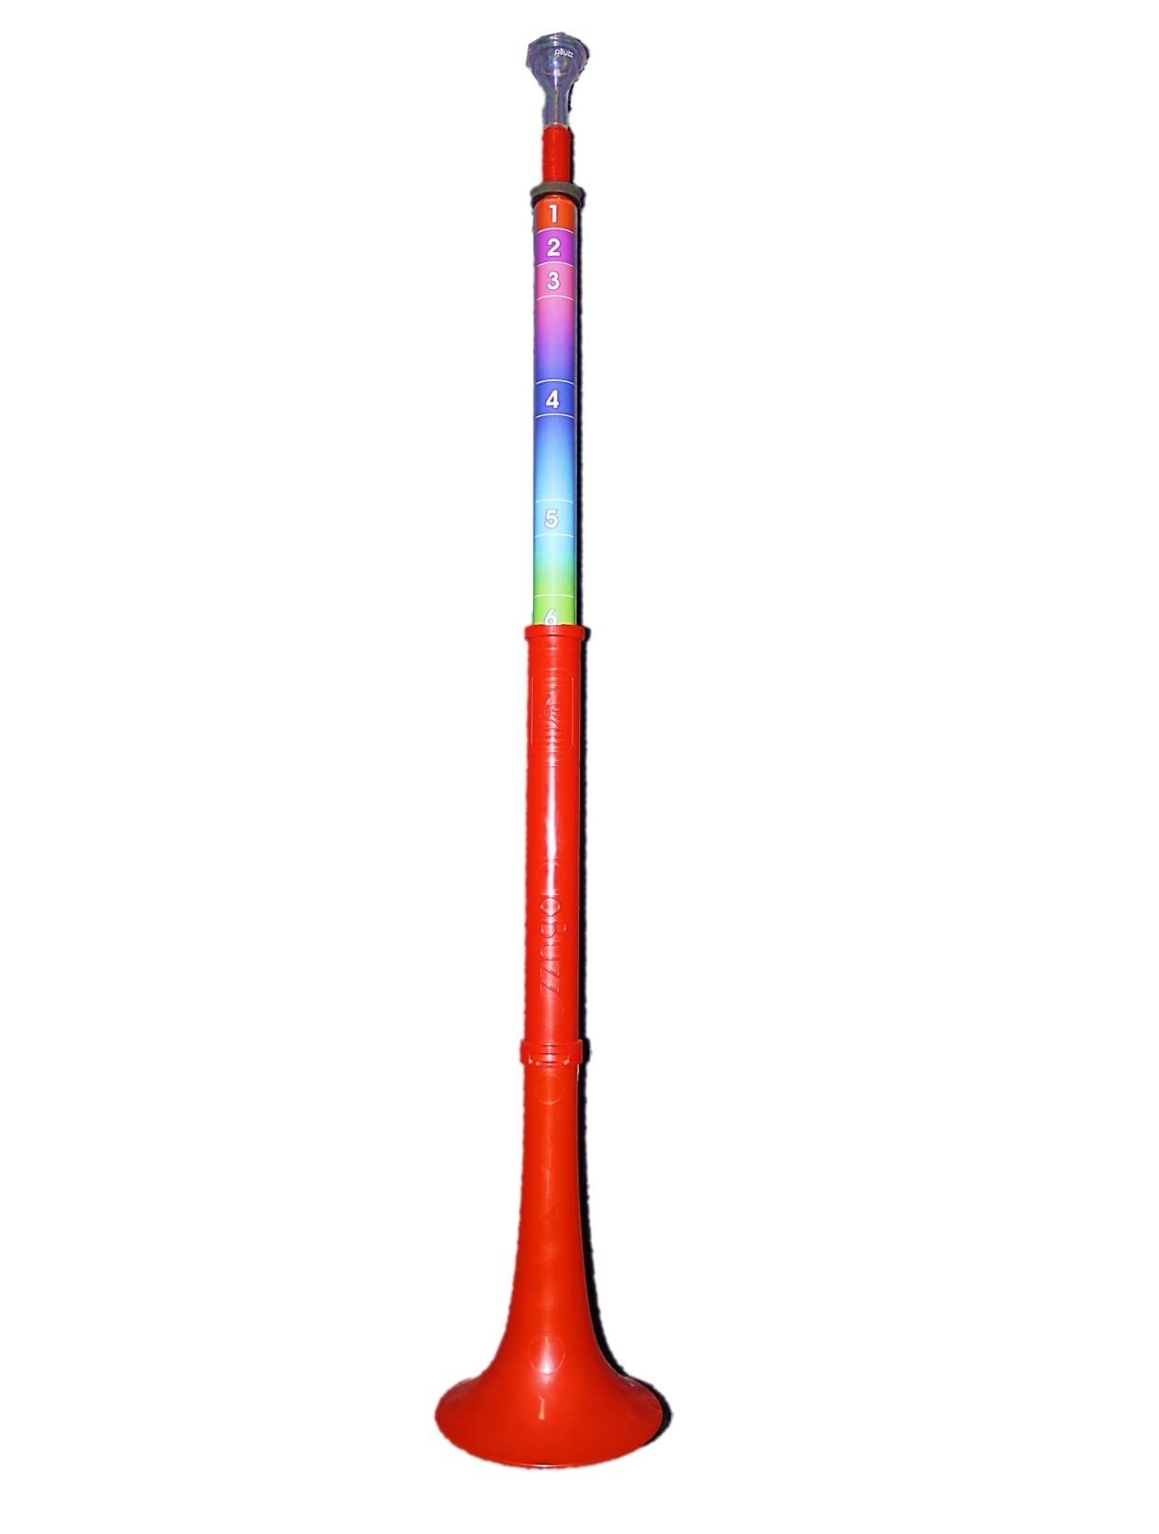

Slide 8
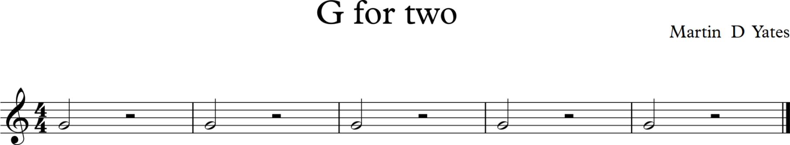
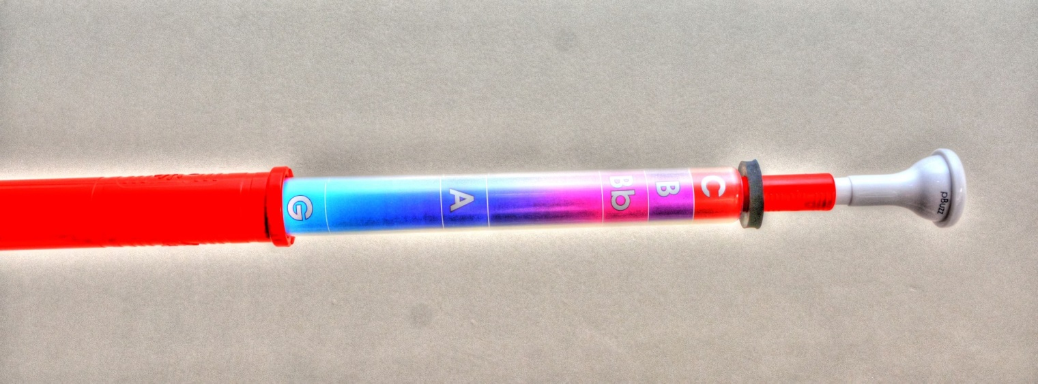

Slide 9
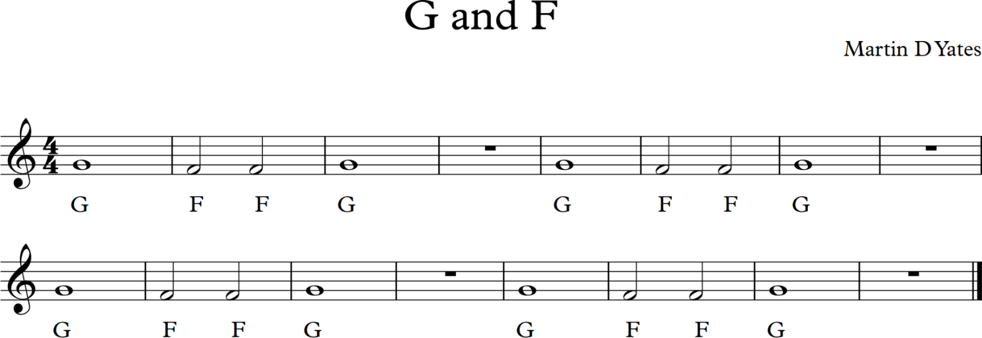

Slide 10
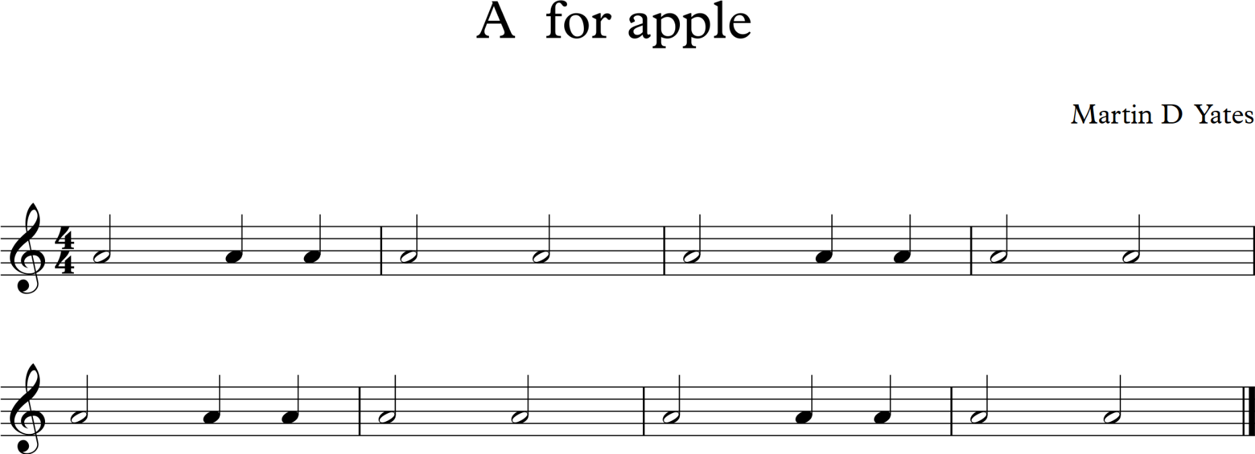
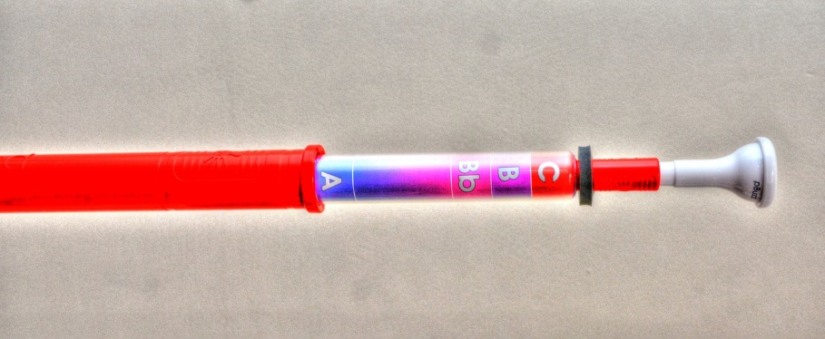

Slide 11
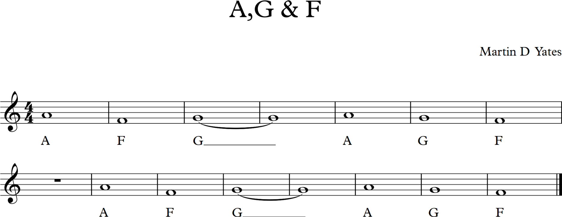

Slide 12
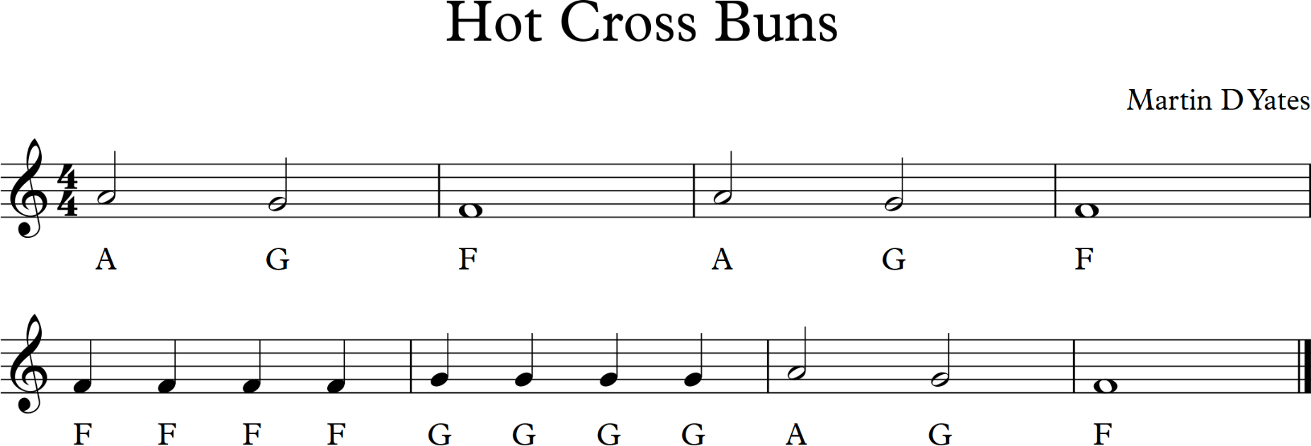

Slide 13
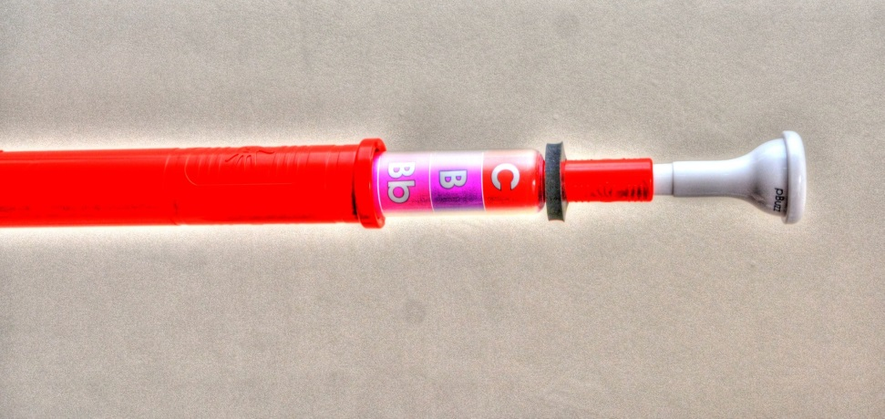
Here is the note Bb. Make sure your pBuzz is on the right note.

Slide 14
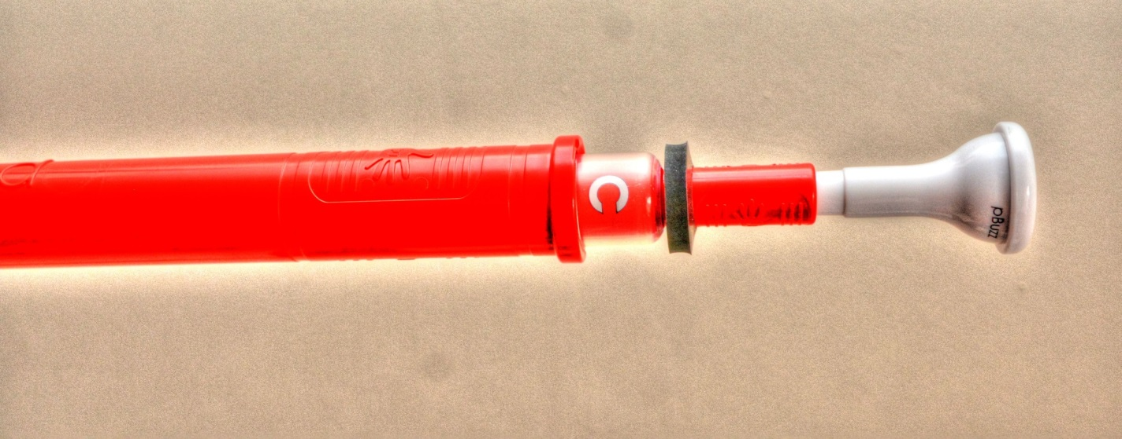
Now try playing a C, check that your pBuzz looks like this.

Slide 15
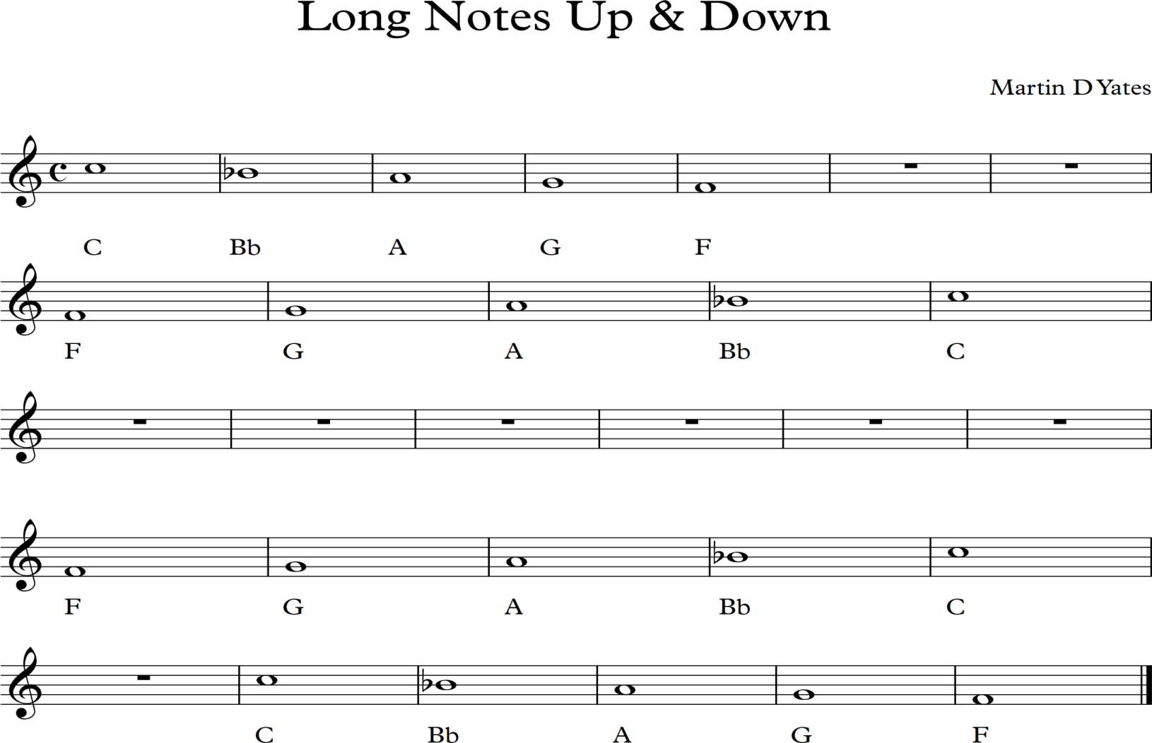

Slide 16
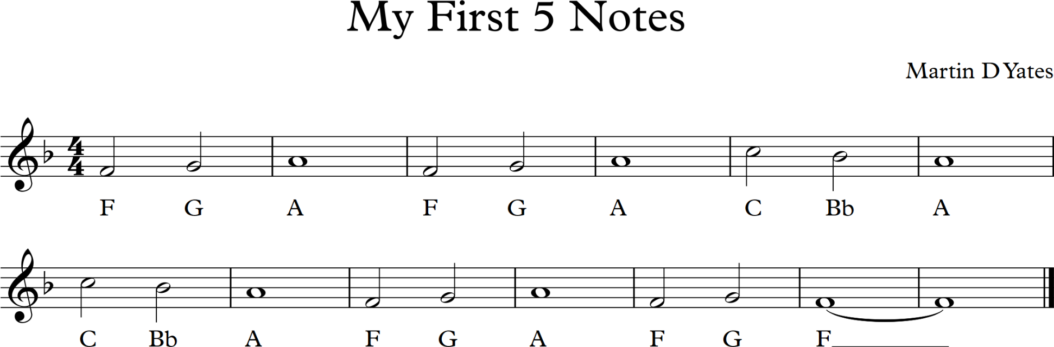
There are more well-known 5 note pieces on www.pbuzz.co.uk/how-to-play/ along with backing tracks.

Slide 17
Extra
Resources

Slide 18
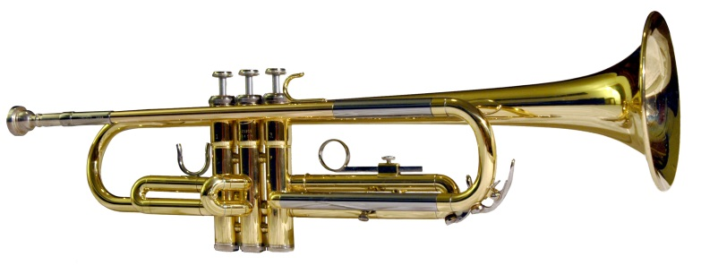
How a Trumpet is made
https://www.youtube.com/watch?v=Yl8qfu-ojTQ

Slide 19
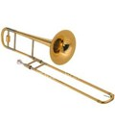
How a Trombone is made
https://www.youtube.com/watch?v=G5LqrMcq1QE

Slide 20
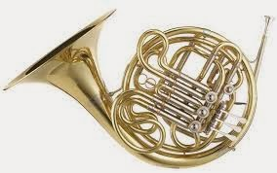
How a French
Horn is made
https://www.youtube.com/watch?v=_eoGFpAiaoc

Slide 21
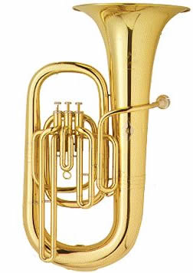
How a Tuba is made
https://www.youtube.com/watch?v=W8-CAYHHPA4

Slide 22
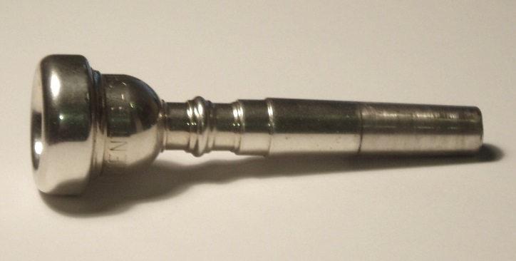
How a Mouthpiece is made
https://www.youtube.com/watch?v=JC-6Yf_mYmg

