Slide 1

pBuzz l pBone l pTrumpet l just play!

Slide 2



Slide 3
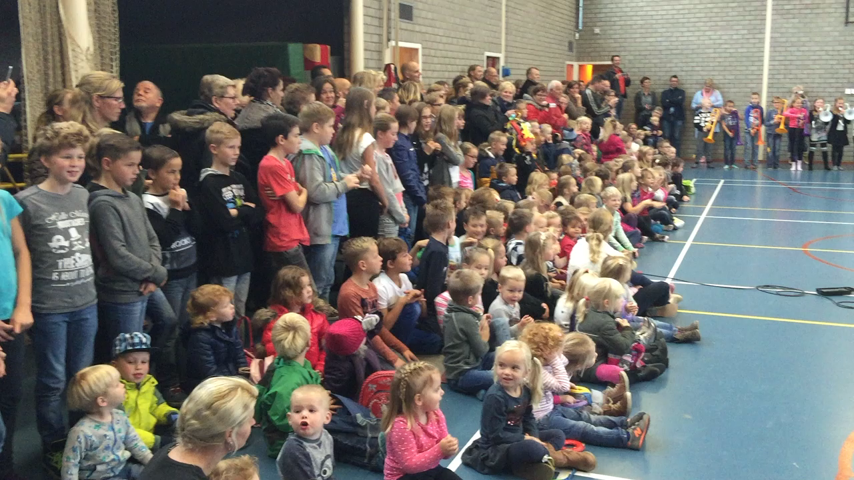
pBuzz: at age 5/6, K2
https://youtu.be/iM8wyoHzLVo
Notes:
Video from file or use hhttps://youtu.be/iM8wyoHzLVo

Slide 4
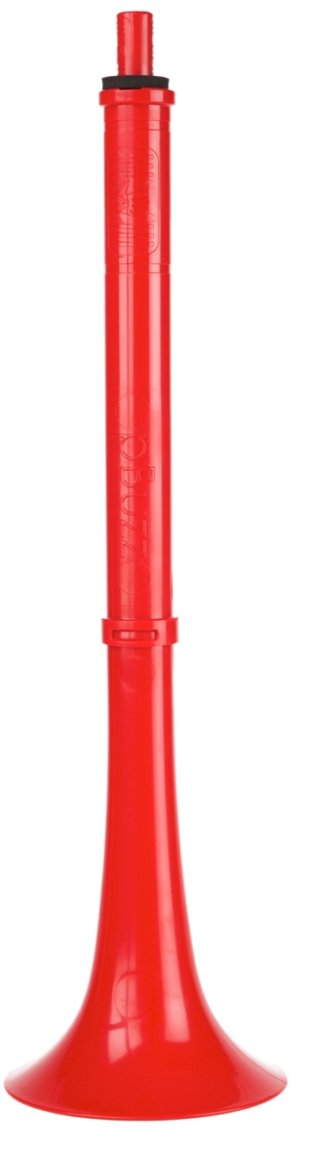
What is pBuzz?
  A new and unique beginner instrument:
  5 inch Bell
  Lightweight
  Range of F-C in concert pitch
  Single harmonic
  Notes, numbers and colours for pitch
  Plastic Material
  Our unique beginner mouthpiece
  Bio-cote in mouthpiece
Notes:
Light:
Ergonomic:
pBuzz is simple to hold
Robust:
pBuzz is constructed from tough plastic
Education:
pBuzz is supplied with our unique beginners mouthpiece featuring Bio-cote anti bacterial additive and is colour coded to help teachers and pupils find their way in the world of pitch.

Slide 5
Todays plan!
Cover the plenary session in more detail
Integrating with your existing offer
Scaffolding: games and parallel learning
Creative practice.
Discussion

Slide 6
Cover the plenary session in more detail
  Posture
  Breathing
  Singing
  Buzzing
  Playing
  Authentic brass learning: air speed and aperture

Slide 7
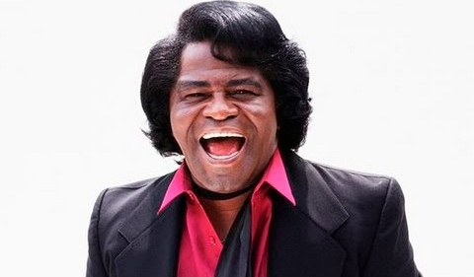

Todays set work
https://youtu.be/prfe0omOcyI
Notes:
Video from file or https://youtu.be/prfe0omOcyI

Slide 8
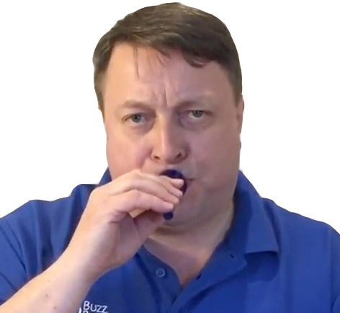
Mouthpiece position:
In the middle of your lips
Point the mouthpiece down slightly but keep your head up, straight!

Slide 9
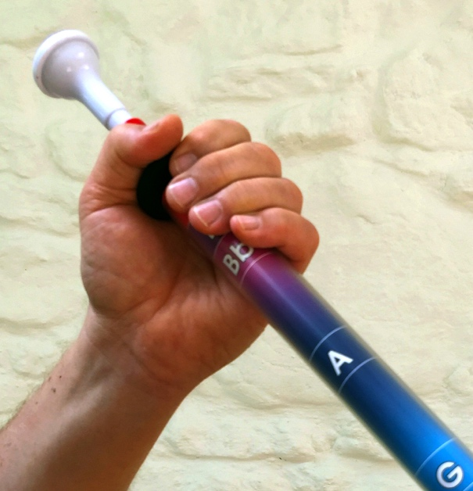
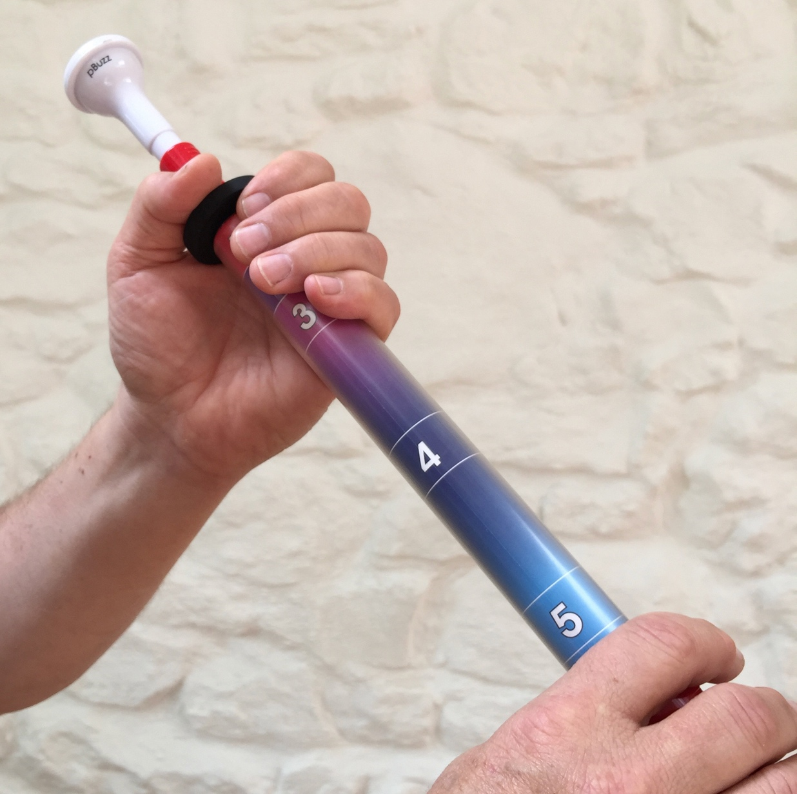
Left hand position
Notes:
Video from file or https://youtu.be/prfe0omOcyI

Slide 10
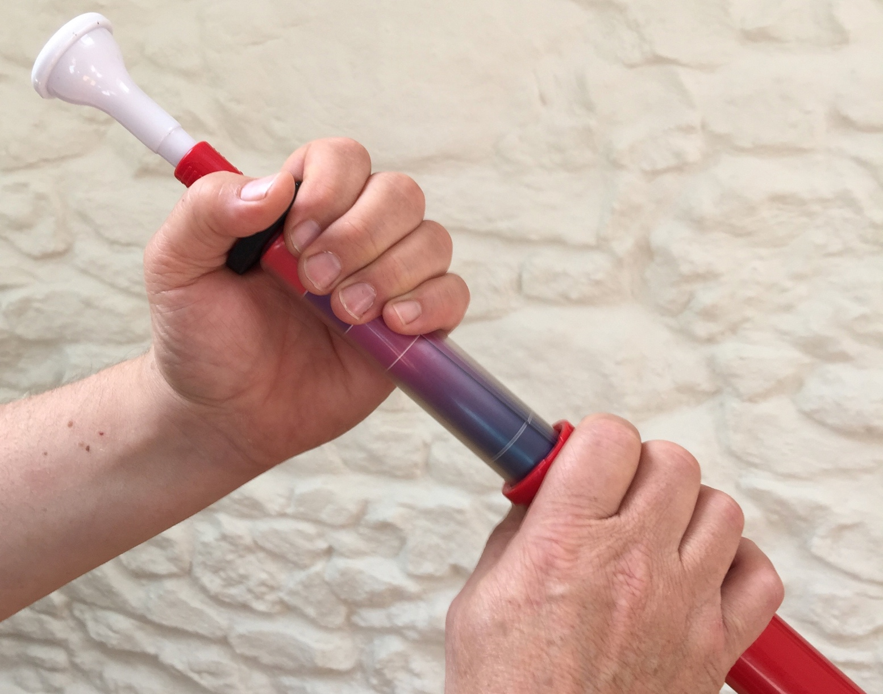
Right hand position
Notes:
Video from file or https://youtu.be/prfe0omOcyI

Slide 11
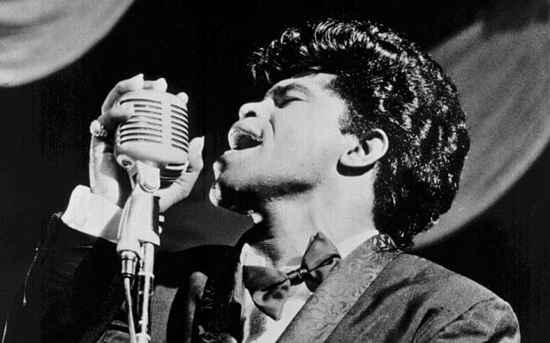
Todays set work
hhttps://youtu.be/prfe0omOcyI
Notes:
Video from file or https://youtu.be/prfe0omOcyI

Slide 12
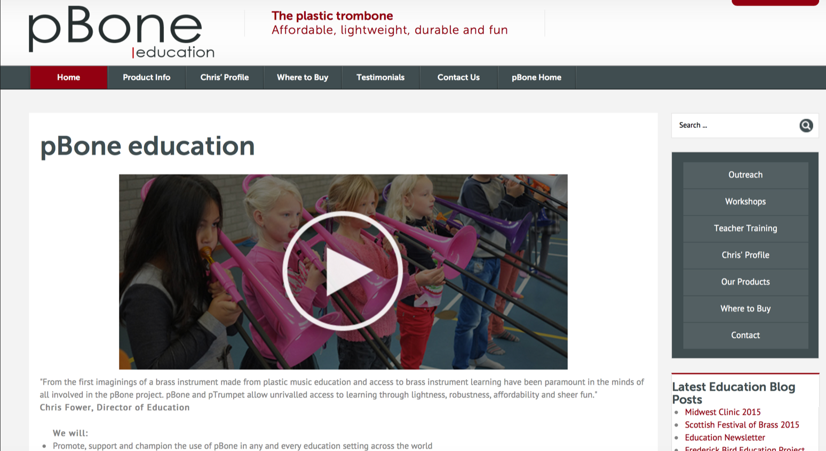
Dedicated education portal
www.pbone.co.uk/education
Education resources, testimonials, news, how to guide
Personalised expert support
Please contact us to share your own experiences education@pbone.co.uk
Notes:
http://www.pbone.co.uk/education

Slide 13
Integrating with your existing offer
  What are we all using?: instruments
  What are we all using?: materials
  Composing and improvising?

Slide 14
Scaffolding: games and parallel learning
  The elements of music?
  Physical acuity
  Broader learning objectives
  Performance practice

Slide 15
Creative Practice.
  Teaching in the target language
  Secure and safe improvising
  Composing
  Maintaining good quality, technical outcomes
  Using the music that pupils bring
  Child centered learning

Slide 16
Progression onto pBone
What is the harmonic series
Why has pBuzz only one harmonic
What are the technical levers to change harmonics?

Slide 17
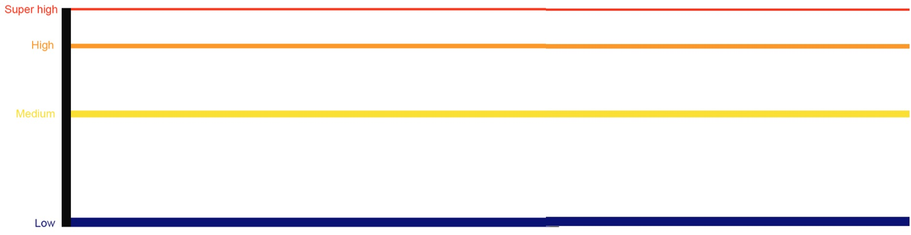







Our “trombone tabs”

Slide 18
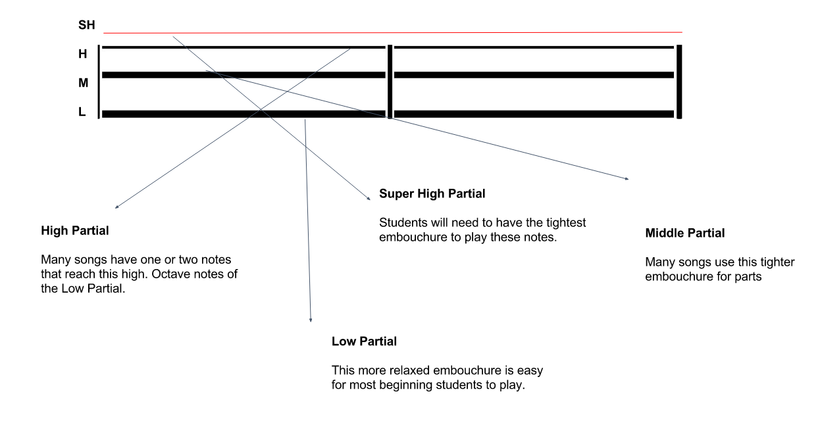
tTabs

Slide 19
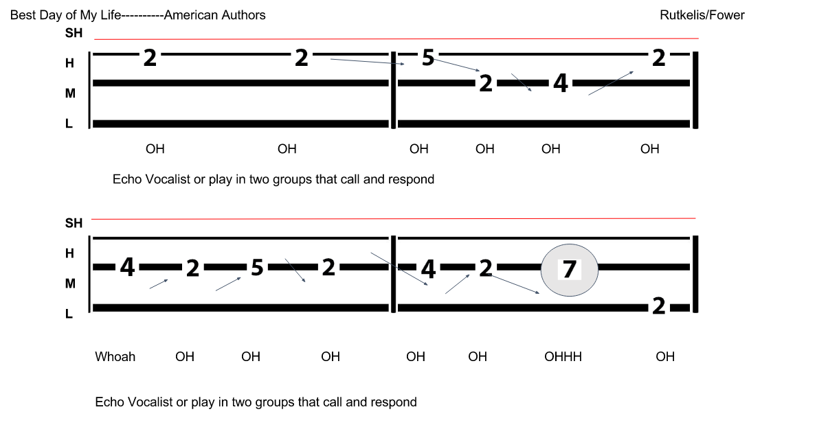
Best Days of My Life
https://youtu.be/Y66j_BUCBMY

Slide 20
What teachers & students say
“Children love the bright colours, their lightness and that they can just pick up, practise and play”
  John Thomson, service manager at SIPS Education Music & Arts Service (Sandwell)
“Cool, great fun to learn on and they shrug off knocks and bangs”
  Tanya Myatt, head of whole-class music learning
“I've played the ukulele before, but learning the pBone was really different and fun”
    Lilly May, Age 9

Slide 21
Please share your own experiences with us
Web
pBone: http://www.pbone.co.uk
pTrumpet: http://www.ptrumpet.com
pBuzz: http://pbuzz.co.uk
Email: education@warwickmusic.com

Slide 22
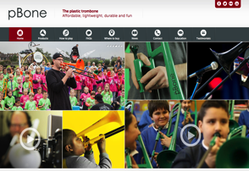
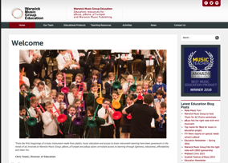
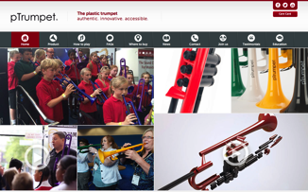
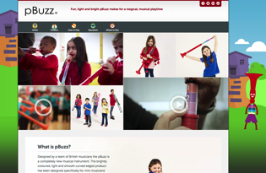
Websites
Digital
Presence
pbone.co.uk
education.warwickmusicgroup.com
ptrumpet.com
pbuzz.co.uk
22

