Slide 1



Slide 2
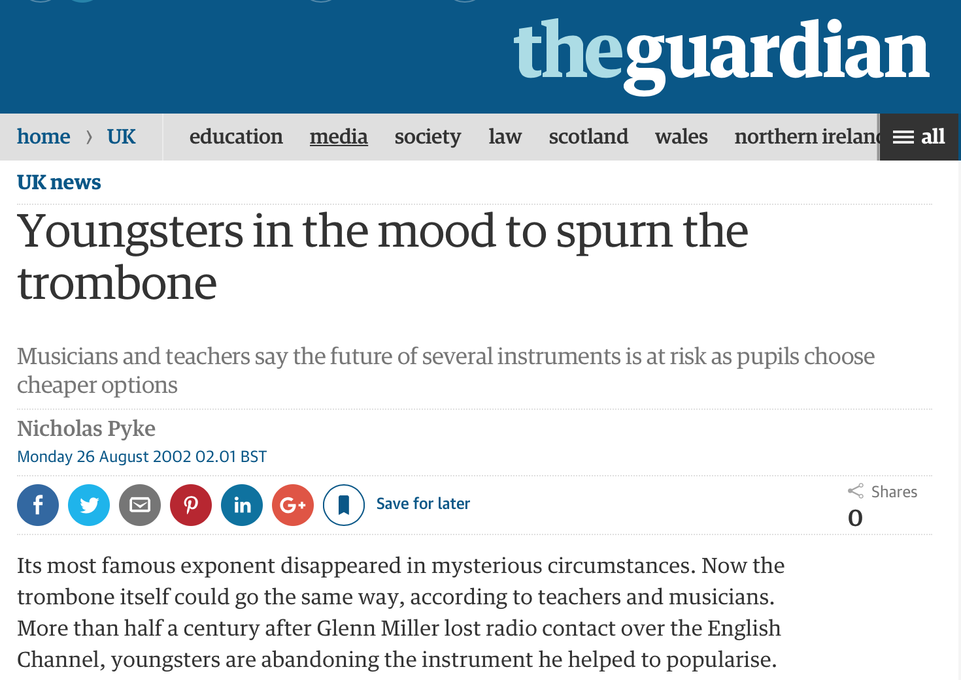
How pBone began?
Trombone officially an “endangered-species”
(UK Government)
Plastic offered unique opportunities to make things easier
Notes:
National Foundation for Youth Music, funded by the UK Government, declared the trombone to be an “endangered species”

Slide 3
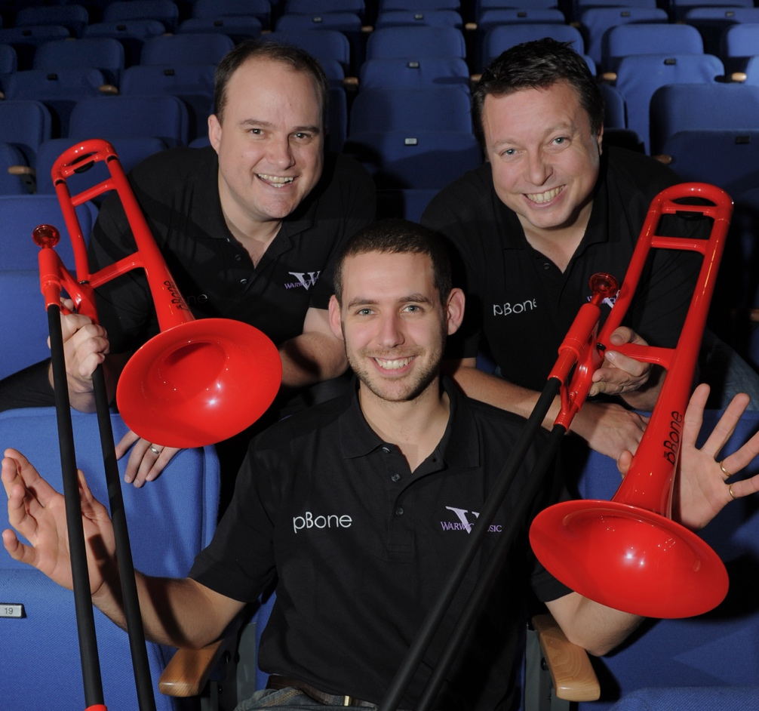
The musicians behind pBone
Meet Steve, Hugh and Chris
British musicians passionate about music-making
Designed and developed in the United Kingdom from 2007-2010

Slide 4
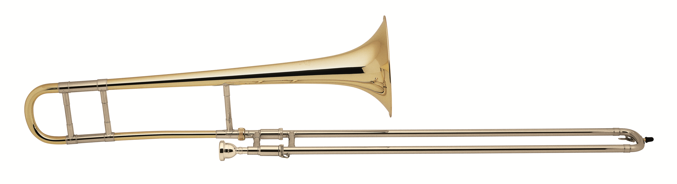
What we wanted to solve?
The brass trombone was:
  Easy to dent and damage
  Heavy and cumbersome to hold
  Not exciting to look at
  Expensive for parents to buy
Make the trombone more accessible
Notes:
When we started in 2007, as teachers and players we were also our customers - evenso we spent a lot of time talking to friends and colleagues in the music world:
Instruments which are light and easy to hold but also robust – suitable for the classroom environment
A unique and distinctive design which is respective of the heritage of the instrument – don’t copy or replace brass
An affordable alternative that gives opportunity to those that can’t afford a (decent!) brass instrument
Something which is fun to play and can be multi-purpose

Slide 5
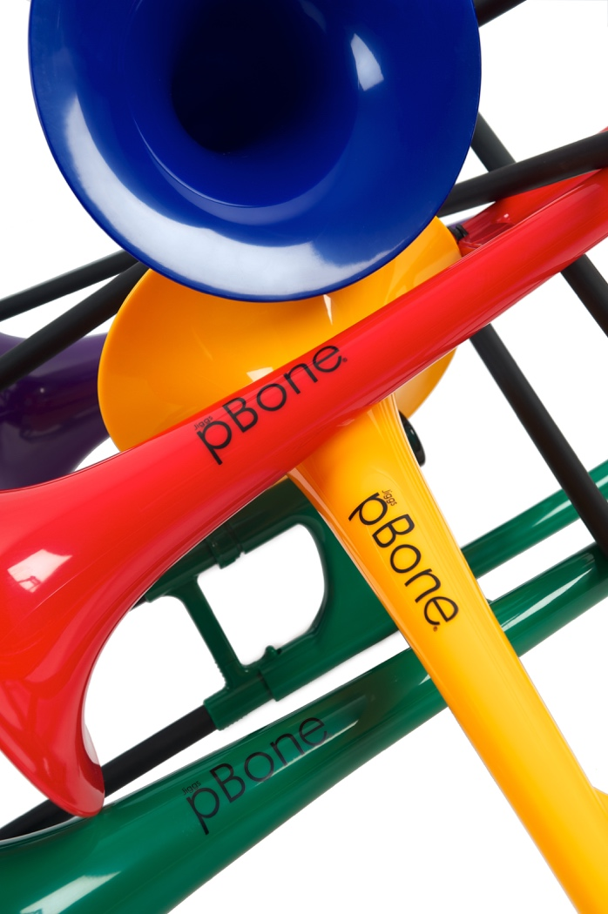
What we delivered
  Unbelievable light
  Incredibly tough and robust
  Rests effortlessly in your hand –large or small
  Easy push fit design
  Patented technology delivers unbeatable sound quality
  Industry leading product quality
  Low cost
  Colourful and fun!
Notes:
Light:
less than half the weight of a brass trombone.
Ergonomic:
pBone’s handles and braces have been designed in order to allow small hands a variety of potential hand positions.
A child can choose from a few ways of gripping on the left hand, a pistol grip is one possibility as is all the fingers around the main tubing.
On the right hand the small hook encourages the correct position of the thumb and discourages using the right hand to support the instrument.
Robust:
pBone is constructed from tough plastic and composite materials.
Fun:
We always wanted the instrument to bring back some of the fun into trombone playing.
No need for long “do’s and don’ts” before letting beginners loose on the instrument.
Children and adults alike are free to explore the instrument without fear of damage.
pBone can” boldly go where no trombone has been before”!
Education:
pBone is supplied with a mouthpiece of around the 11c size, adapted by us for the nature of a plastic instrument, this is an ideal beginner mouthpiece, especially for smaller set of lips.

Slide 6
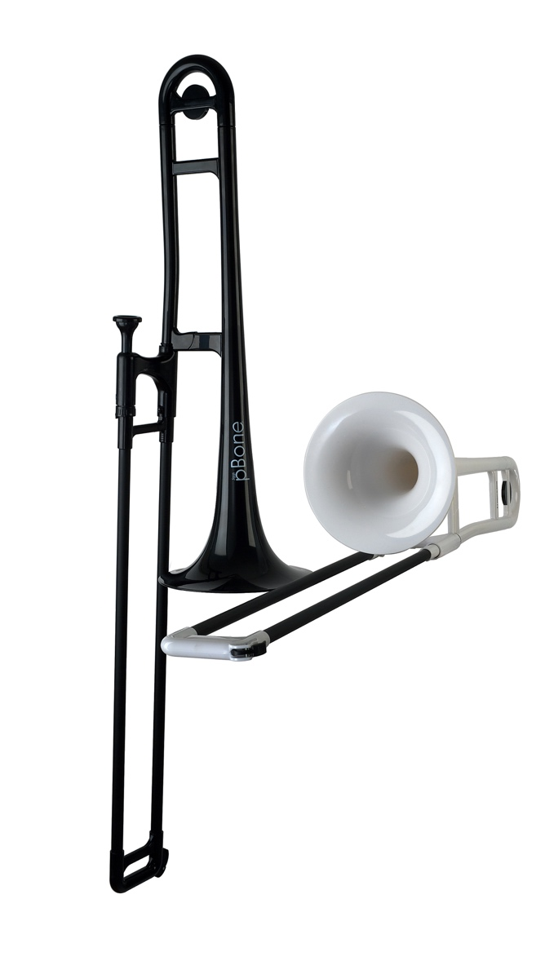
What is pBone?
  A fully functional Bb tenor trombone:
  8-inch Bell
  .500 medium bore
  Weighs 1.8 pounds (half the weight!)
  Fabric carry bag
  Lockable slide
  Pitched in Bb
  Water key
  Plastic Material
  9 colours available
  11c small shank mouthpiece
Notes:
Light:
less than half the weight of a brass trombone.
Ergonomic:
pBone’s handles and braces have been designed in order to allow small hands a variety of potential hand positions.
A child can choose from a few ways of gripping on the left hand, a pistol grip is one possibility as is all the fingers around the main tubing.
On the right hand the small hook encourages the correct position of the thumb and discourages using the right hand to support the instrument.
Robust:
pBone is constructed from tough plastic and composite materials.
Fun:
We always wanted the instrument to bring back some of the fun into trombone playing.
No need for long “do’s and don’ts” before letting beginners loose on the instrument.
Children and adults alike are free to explore the instrument without fear of damage.
pBone can” boldly go where no trombone has been before”!
Education:
pBone is supplied with a mouthpiece of around the 11c size, adapted by us for the nature of a plastic instrument, this is an ideal beginner mouthpiece, especially for smaller set of lips.

Slide 7
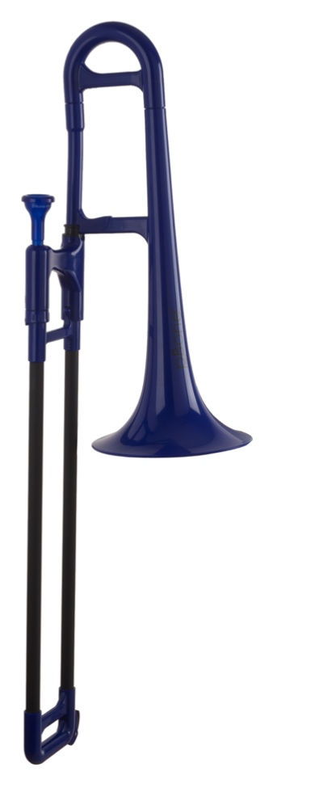
What is pBone mini?
  A fully functional dual-bore Eb alto trombone:
  7-inch Bell
  Weighs 1.6 pounds (half the weight!)
  Fabric carry bag
  Lockable slide
  Pitched in Eb
  Water key
  Plastic Material
  2 colours available
  11c small shank mouthpiece
Notes:
Light:
less than half the weight of a brass trombone.
Ergonomic:
pBone’s handles and braces have been designed in order to allow small hands a variety of potential hand positions.
A child can choose from a few ways of gripping on the left hand, a pistol grip is one possibility as is all the fingers around the main tubing.
On the right hand the small hook encourages the correct position of the thumb and discourages using the right hand to support the instrument.
Robust:
pBone is constructed from tough plastic and composite materials.
Fun:
We always wanted the instrument to bring back some of the fun into trombone playing.
No need for long “do’s and don’ts” before letting beginners loose on the instrument.
Children and adults alike are free to explore the instrument without fear of damage.
pBone can” boldly go where no trombone has been before”!
Education:
pBone is supplied with a mouthpiece of around the 11c size, adapted by us for the nature of a plastic instrument, this is an ideal beginner mouthpiece, especially for smaller set of lips.

Slide 8
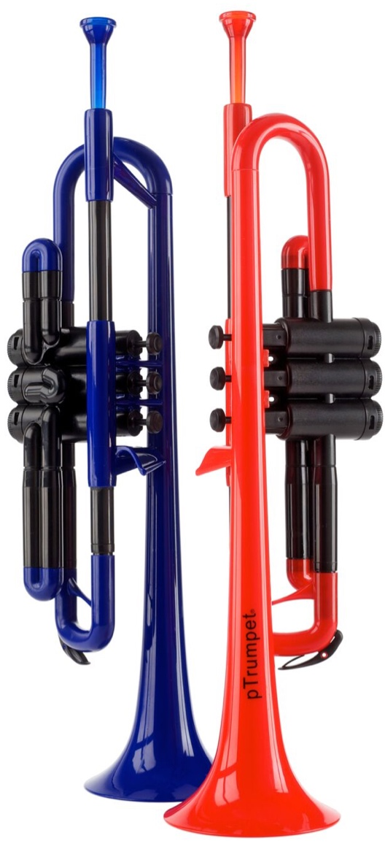
What is pTrumpet?
  A fully functional Bb trumpet:
  4.75 inch Bell
  Weighs 1.1 pounds (half the weight!)
  Fabric carry bag
  Fully plastic valve system
  Pitched in Bb
  Water keys
  Plastic Material
  6 colours available
  3c and 5c mouthpieces
Notes:
Light:
less than half the weight of a brass trumpet.
Ergonomic:
pTrumpet has been designed in order to allow small hands a variety of potential hand positions.
Robust:
Trumpet is constructed from tough plastic and composite materials.
Fun:
We always wanted the instrument to bring back some of the fun into trombone playing.
No need for long “do’s and don’ts” before letting beginners loose on the instrument.
Children and adults alike are free to explore the instrument without fear of damage.
pTrumpet can” boldly go where no trumpet has been before”!
Education:
pTrumpet is supplied with two mouthpieces of around the 3c and 5c size, adapted by us for the nature of a plastic instrument, this is an ideal beginner mouthpiece, especially for smaller set of lips.

Slide 9
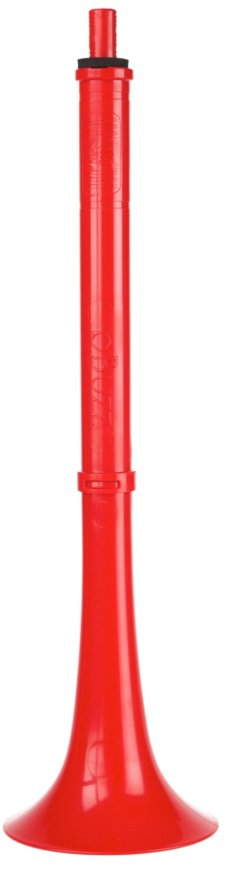
What is pBuzz?
  A new and unique beginner instrument:
  5 inch Bell
  Lightweight
  Range of F-C in concert pitch
  Single harmonic
  Notes, numbers and colours for pitch
  Plastic Material
  Our unique beginner mouthpiece
  Bio-cote in mouthpiece
Notes:
Light:
Ergonomic:
pBuzz is simple to hold
Robust:
pBuzz is constructed from tough plastic
Education:
pBuzz is supplied with our unique beginners mouthpiece featuring Bio-cote anti bacterial additive and is colour coded to help teachers and pupils find their way in the world of pitch.

Slide 10
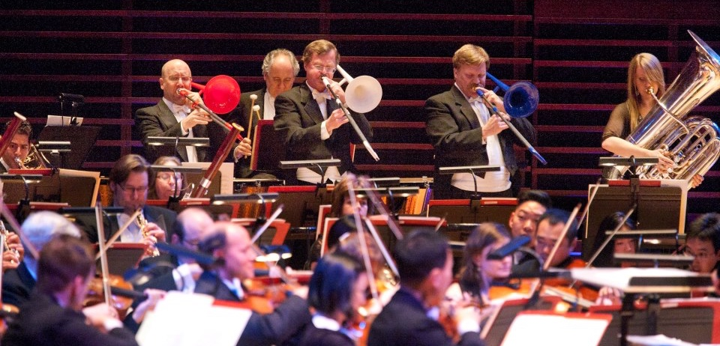
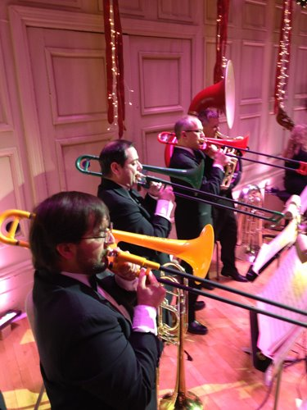
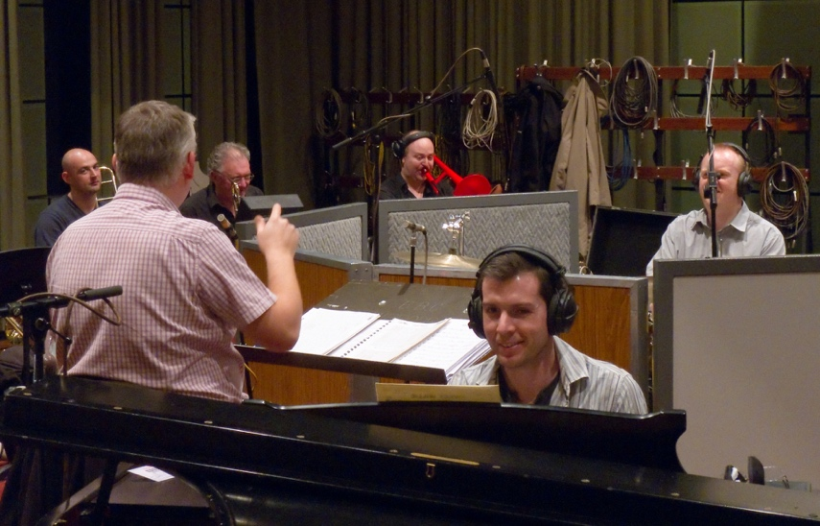
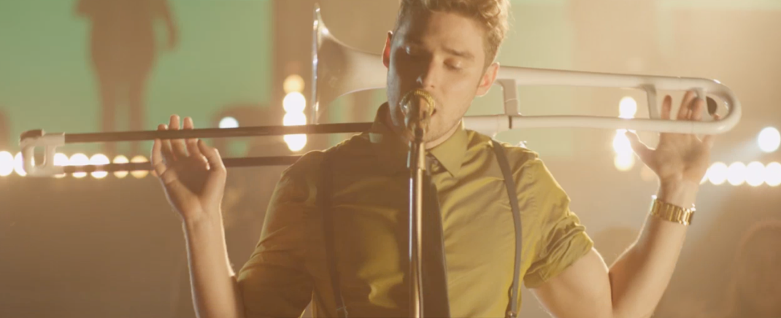
Used by professionals . . .
Notes:
Philadelphia Orchestra (4th July concert)
Boston Symphony (Christmas concert)
BBC Big Band, London – spot the pBone
Karmin Pop Band, Music Video

Slide 11
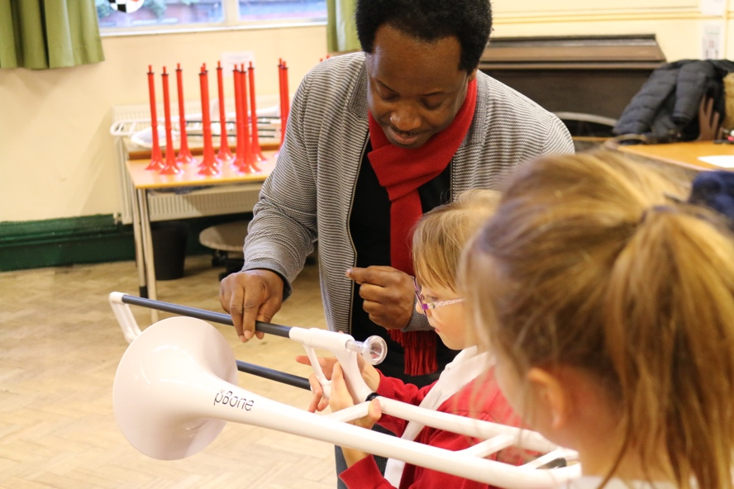
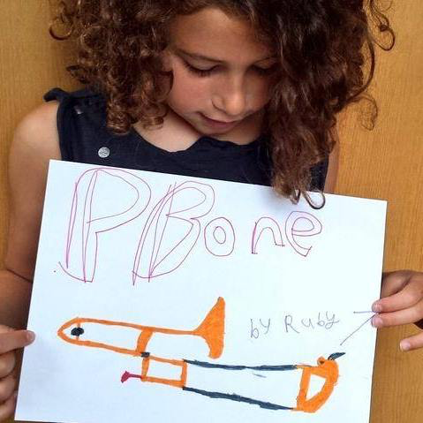
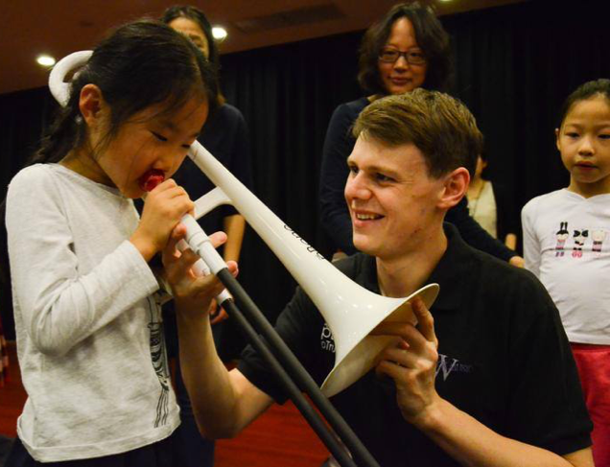
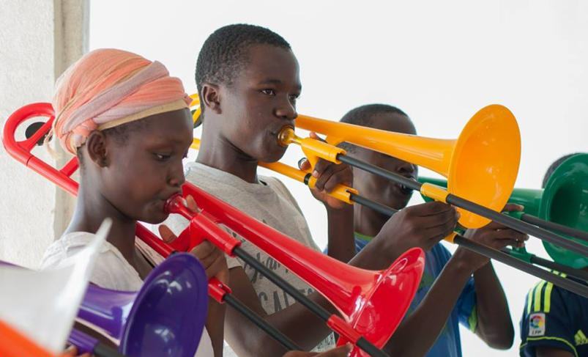
. . . and future professionals
Notes:
Shanghai Music Theater
Liberia Band
Weelock Primary School, UK
Ruby, age 7

Slide 12
pBuzz: at age 5/6, K2
https://youtu.be/yNzvlNkz2CM
Notes:
Video from file or use https://youtu.be/yNzvlNkz2CM

Slide 13
Progressing to pBone mini at first grade
https://youtu.be/Izm3DgDrVfM
Notes:
Video from file or use https://youtu.be/Izm3DgDrVfM

Slide 14
Now to pBone at grades 4/5 after just two sessions!
https://youtu.be/6oTM-qceou8
Notes:
Video from file or use https://youtu.be/6oTM-qceou8

Slide 15
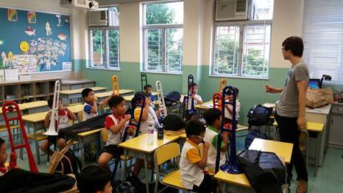
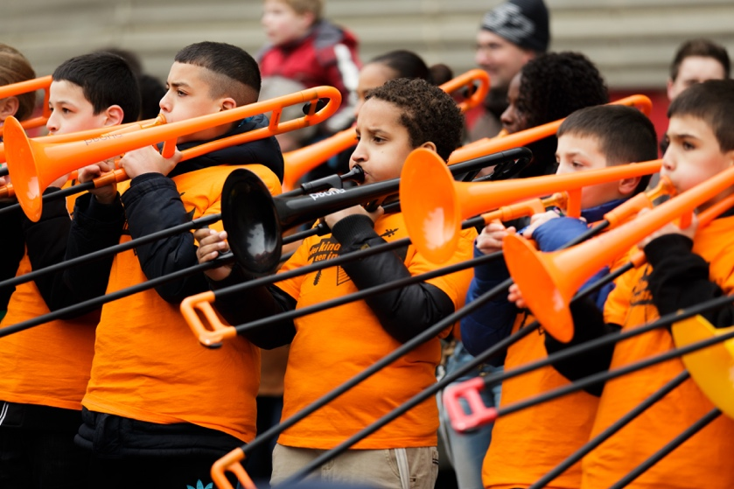
pBone in the classroom
Because of their ease-of-use, “pInstruments” are perfect for outreach projects in small groups, classrooms and even mass ensembles

Slide 16
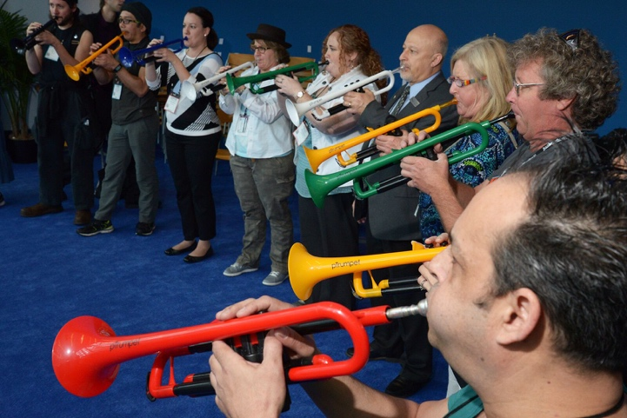
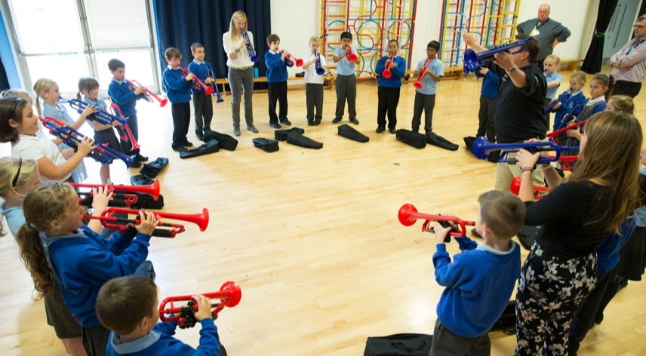
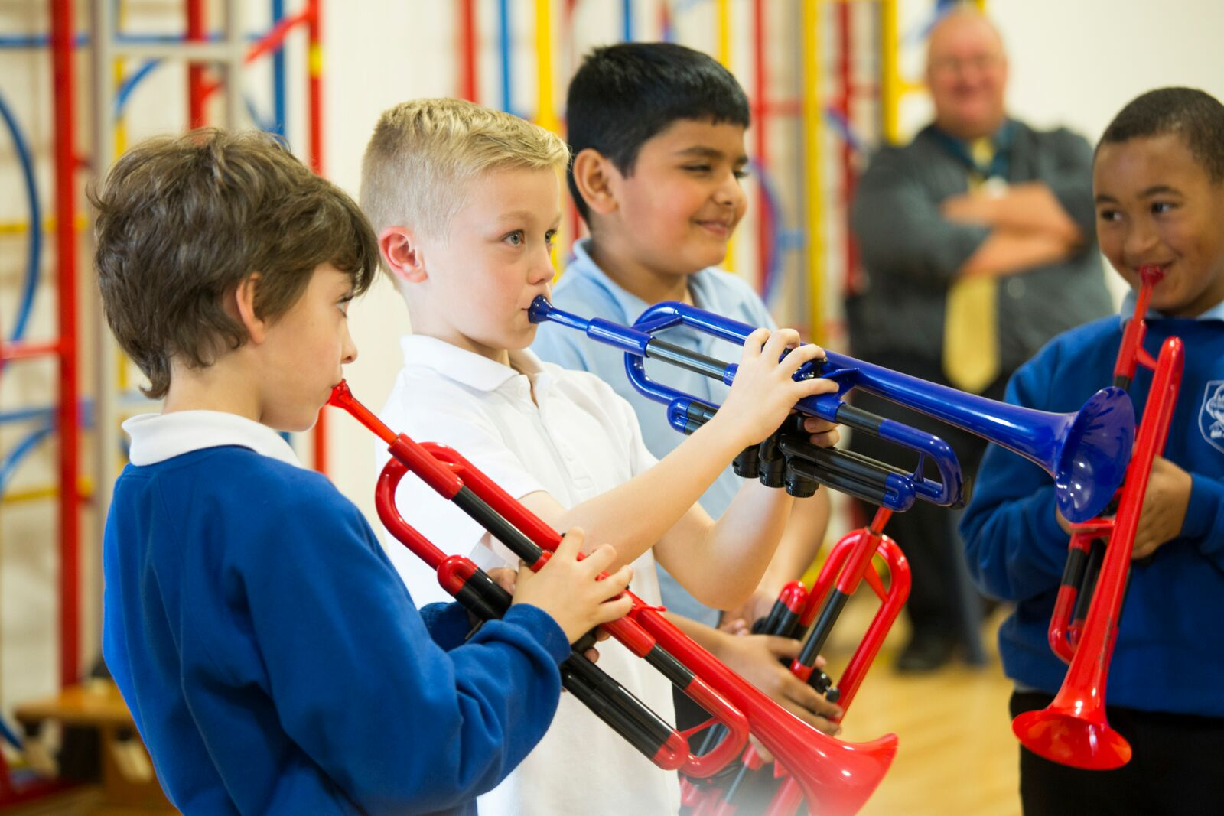
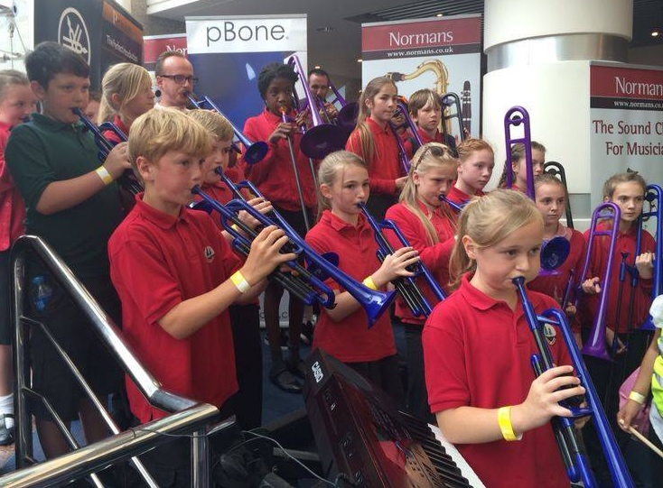
pTrumpet in the classroom

Slide 17
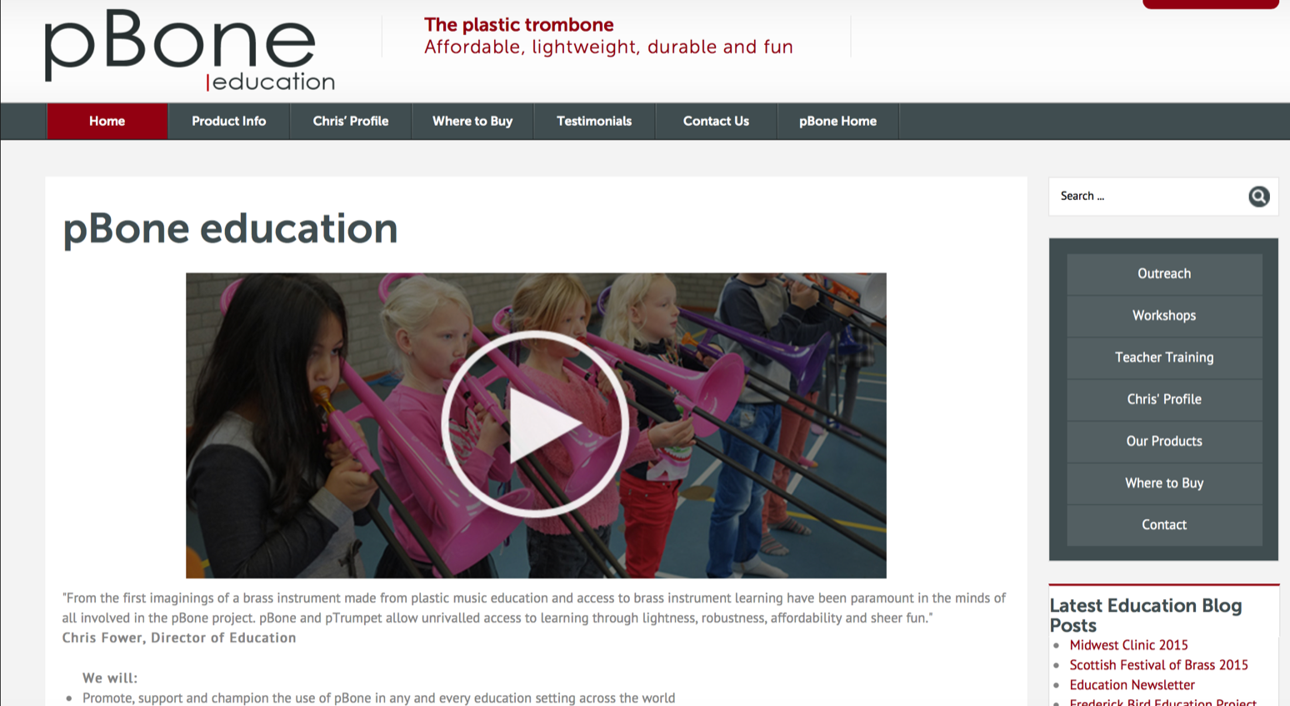
Dedicated education portal
www.pbone.co.uk/education
Education resources, testimonials, news, how to guide
Personalised expert support
Please contact us to share your own experiences education@pbone.co.uk
Notes:
http://www.pbone.co.uk/education

Slide 18
What teachers & students say
“Children love the bright colours, their lightness and that they can just pick up, practise and play”
  John Thomson, service manager at SIPS Education Music & Arts Service (Sandwell)
“Cool, great fun to learn on and they shrug off knocks and bangs”
  Tanya Myatt, head of whole-class music learning
“I've played the ukulele before, but learning the pBone was really different and fun”
    Lilly May, Age 9

Slide 19
How and why pInstruments work in informal settings
Accessibility
High acceptance by children
Ownership by children
Opportunities for action learning
Quality brass outcomes…the Jacobs way
Sing, Buzz, Play
Brass learning circles
Creative opportunities

Slide 20
pCircle plan

Slide 21
One semester program

Slide 22
One year UK style program

Slide 23
Please share your own experiences with us
Web
pBone: http://www.pbone.co.uk
pTrumpet: http://www.ptrumpet.com
pBuzz: http://pbuzz.co.uk
Email: education@warwickmusic.com

